Slide 1

IDENTIFICATION OF FAKE NEWS IN SOCIAL MEDIA USING SENTIMENTAL ANALYSIS
SUBMITTED BY : JOVITHA SWENA JOSEPH WILSON
STUDENT ID :20220603

Slide 2



Slide 3

The main objective is to implement an automatic, more feasible system to detect fake news from social media platforms.
Identify the main variants that play an important role.
Evaluate the challenges that are faced when using sentimental analysis.
Identify an effective model detect fake news in large datasets.
Manage fake news to be detected automatically with efficient accuracy in social media.

Slide 4







Slide 5
RESEARCH HYPOTHESIS
Fake news articles are more likely to contain negative sentiments than real news articles.
The sentiment expressed in headlines plays a crucial role in shaping readers' initial perception and interest.
Sentiment analysis can effectively distinguish between fake news and real news.
Different sentiment analysis techniques, vary in their effectiveness for detecting fake news.

Slide 6
RELATED WORKS
Fake News Definition : Disinformation , misinformation and rumours.
Correlation between emotions and fake news.
Sentimental analysis :
Machine learning and Deep Learning Like LSTM and BERT for detecting fake news.
Lexicon based approach for analysing reviews and tweets.
Gaps : Calculating Sentimental Polarity for the fake news.

Slide 7


Slide 8
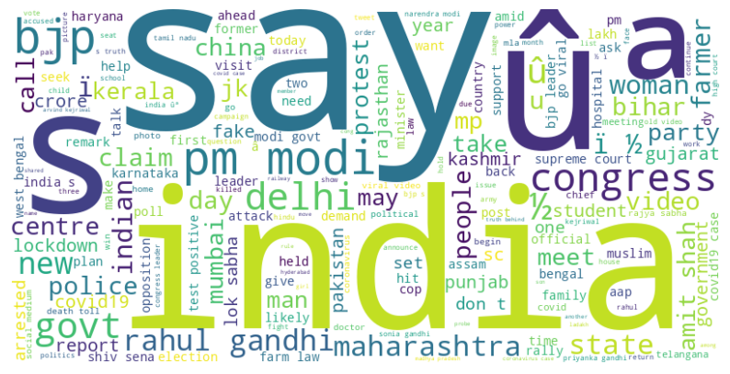
DATASET
The dataset used is Indian Fake News Detection.
Time frame from 2004 - 2021.
Contains about 56714 news headlines in which 37800 headlines are true and 18914 are fake headlines.
Various categories- COVID-19, election, government, misleading, politics, terrorism, trad and violence

Slide 9
SENTIMENTAL ANALYSIS
Lexicon- Based
Machine Learning
Sentiment Polarity- Sentimental Score, Emotional Ratio, Positive Ratio and Negative Ratio.
Valence Aware Dictionary and Sentiment Reasoner-VADER Method
Correlation between length of the statement and sentiment score.
SUPERVISED LEARNING TECHNIQUES
Logistic Regression,
Naive Byes and
SVM

Slide 10
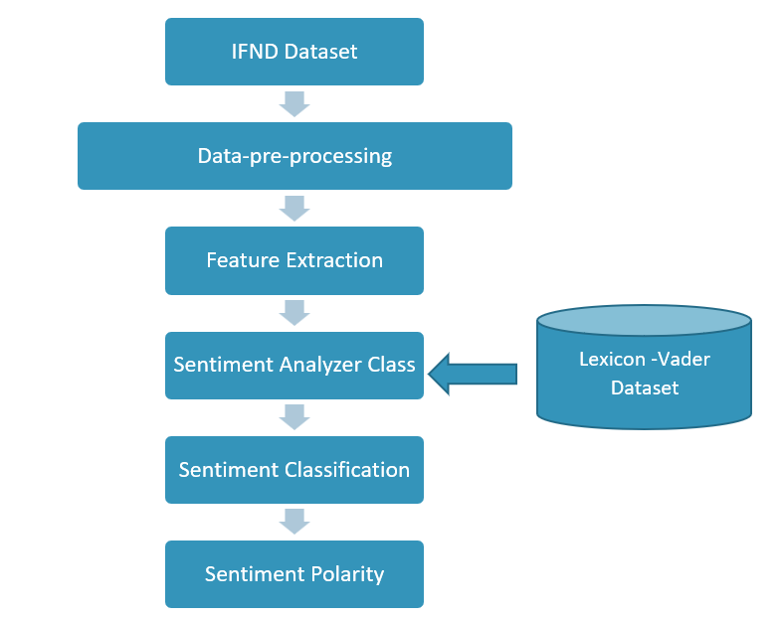
Lexicon- Based Sentimental Analysis

Slide 11
Data-Pre-Processing
Removing unwanted columns and words using drop function.
Cleaning the Text using isnull.
Converting text to lowercase using lower string.
Removing the Special Characters using Maketrans string.
Stop words removal by importing stop words from nltk.corpus.
Lemmatization by import WordNetLemmatizer from nltk.stem.
Natural Language Processing One-hot encoding technique.
Tokenization by using word_tokenize function.

Slide 12
Feature Extraction
TF-IDF technique is used for feature extraction for our dataset
By implementing TF-IDF using the TfidfVectorizer.
It is the process of find the important words in the news statement concerning their importance in the entire text corpus.
It allocates high weightage to the words that have occurred frequently.
Important step in text analysis.

Slide 13
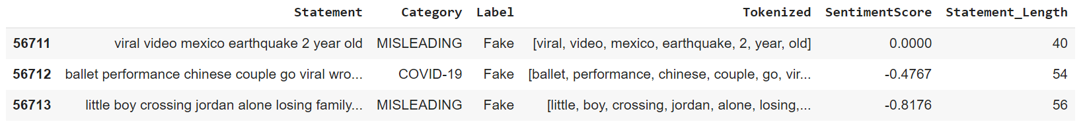
SENTIMENTAL POLARITY
Quantity measure of the sentiment expressed in individual text. VADER Method by using SentimentIntensityAnalyzer.
sentiment_score = sentimentanalyser.polarity_scores(statement)

Slide 14
MACHINE LEARNING Supervised Learning Techniques
Logistic Regression
Suitable model for binary classification problems.
Adopts linear relationship between input feature (News Headlines), and the targeting variable (F/T).
Naïve Bayes
This model works on the principle by calculating the probability of each text belonging to particular class(F/T) sentiments. Based on the probability of each discrete feature taking place in each class.
Handle high-dimensional feature spaces effectively as it assumes independence among features. Which is more suitable for text-analysis.

Slide 15
MACHINE LEARNING Supervised Learning Techniques
Support Vector Machine
This model handles non-linear decision boundaries effectively. As It aims to find the decision boundary with the maximum margin between the classes.
It captures complex relationships in the data.
Hyper-parameter tuning-SVM
To improve the performance of the SVM model
It avoids over-fitting or underfitting of data

Slide 16
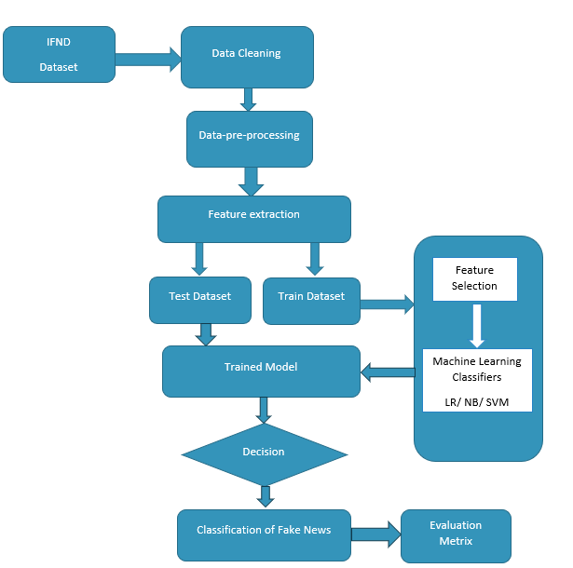
MACHINE LEARNING

Slide 17
Feature Selection
It is the process of identifying and retain the most informative and discriminative features with a strong relationship with the target variable.
Chi-square test is used in this research.
This test identifies the relevant features that contribute a vital role in classifying fake and real news.
It is done to improved the performance of the model and to train the model faster and get the output faster

Slide 18
Findings
Evaluation Metrics
 | Accuracy | Precision | Recall | F1_score
LR | 0.9273 | 0.9165 | 0.6281 | 0.7454
NB | 0.9205 | 0.9259 | 0.5773 | 0.7112
SVM | 0.9309 | 0.9229 | 0.6462 | 0.76022
H-SVM | 0.9349 | 0.8809 | 0.7120 | 0.7875

Slide 19
Findings…..
What are the main features that play a vital role in detecting fake news with respect to emotions?
The challenges that are faced when using sentimental analysis for the detection of fake news?
Which model is more suitable for detecting fake news in large datasets?
Is detecting fake news automatically with efficient accuracy possible in real-time?

Slide 20



Conclusion
This Photo by Unknown Author is licensed under CC BY

Slide 21


